Slide 1


Bike Share Toronto Data Analysis & Predictions with Machine Learning & Power BI
Mohit Rathod | Data Analyst
Humber Polytechnic, Toronto, ON, Canada
2nd International Data Science and Analytics Students Conference
Hosted by the University of Calgary
Saturday, March 22nd, 2025

Slide 2
Introduction
Bike Share Toronto is a public bicycle-sharing system serving the city of Toronto, Canada. It is operated by the Toronto Parking Authority and aims to promote sustainable urban mobility by providing an affordable, eco-friendly transportation alternative.
Launched: 2011
Operator: Toronto Parking Authority
Stations: Over 625 docking stations across the city
Bicycles Available: More than 7,000 bikes
Service Area: Covers downtown Toronto and expanding suburban areas
Pricing: Includes pay-as-you-go, monthly, and annual membership plans
Technology: Features GPS tracking, mobile app integration, and real-time bike availability updates
Created by Mohit Rathod | Data Analyst

Slide 3
Key Challenges & Objectives
Issue
Significance
Objectives
Toronto’s Bikeshare system has growing demand but lacks an optimized approach for demand forecasting.
Helps city planners, bikeshare operators, and policy makers optimize services.
Analyze user trends, predict future demand, and visualize key insights.
Key Questions:
Which stations are busiest? What are peak hours? Can we predict demand?
Created by Mohit Rathod | Data Analyst

Slide 4
Methodology (Data & Tools Used)
Data Source
Tools & Techniques
Visualization
Ridership Data
Station Information
Python
Power BI
Google Colab
Power BI
Seaborn/Matplotlib
Machine Learning
Feature Engineering
Machine Learning Algorithm
Encoding Techniques
Feature Scaling & Selection
Time-Based Features
Station & Demand Features
User Behavior Features
Created by Mohit Rathod | Data Analyst

Slide 5
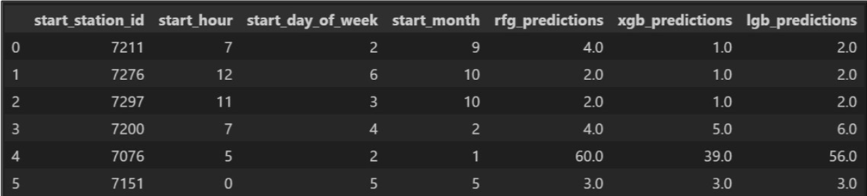
Station Demand Forecasting
Goal: Predict trip demand for better inventory management & station optimization.
Algorithm Used: LightGBM (Light Gradient Boosting Machine)
Model Accuracy: R² = 0.70, RMSE = 3.89%
Feature Importance: Starting station, starting hour of the day, starting month, day of the week
Created by Mohit Rathod | Data Analyst

Slide 6
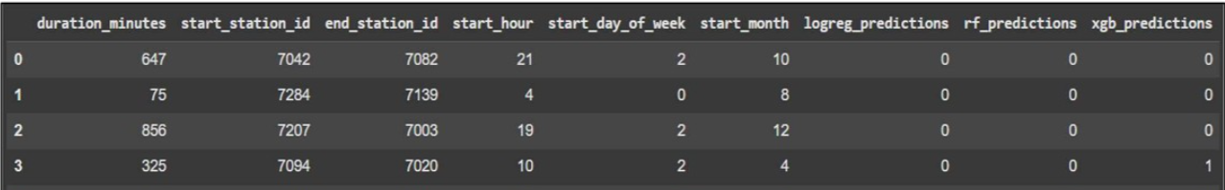
User Classification & Predictions
Goal: Predict trip demand for better inventory management & station optimization.
Algorithm Used: Random Forest Classifier
Model Accuracy: Accuracy = 96.08%, F1 Score = 0.9796
Feature Importance: Trip Duration, Starting Station, Ending Station, Hour of the Day, Day of the Week, Starting Month
User Type Segmentation:
Casual Users: Prefer weekends, longer trips, and leisure-oriented routes.
Annual Members: Ride on weekdays, shorter trips, and use bikes for daily commutes.
Created by Mohit Rathod | Data Analyst

Slide 7
Station Clustering & Classification
Goal: Group stations based on demand patterns to optimize bike redistribution and infrastructure planning
Algorithm Used: K-Means Clustering
Feature Importance: Total rides per station, proximity to transit hubs, peak hour demand, seasonal variation in demand
Clusters Name: Downtown Core (142), West End (73), Uptown (63), East End (55), East York (26)
Potential Cluster Categories:
High-Demand Stations (Frequent rentals/returns, e.g., downtown hubs)
Moderate-Demand Stations (Balanced inflow and outflow)
Low-Demand Stations (Used occasionally, mostly off-peak hours)
Created by Mohit Rathod | Data Analyst

Slide 8

Created by Mohit Rathod | Data Analyst

Slide 9
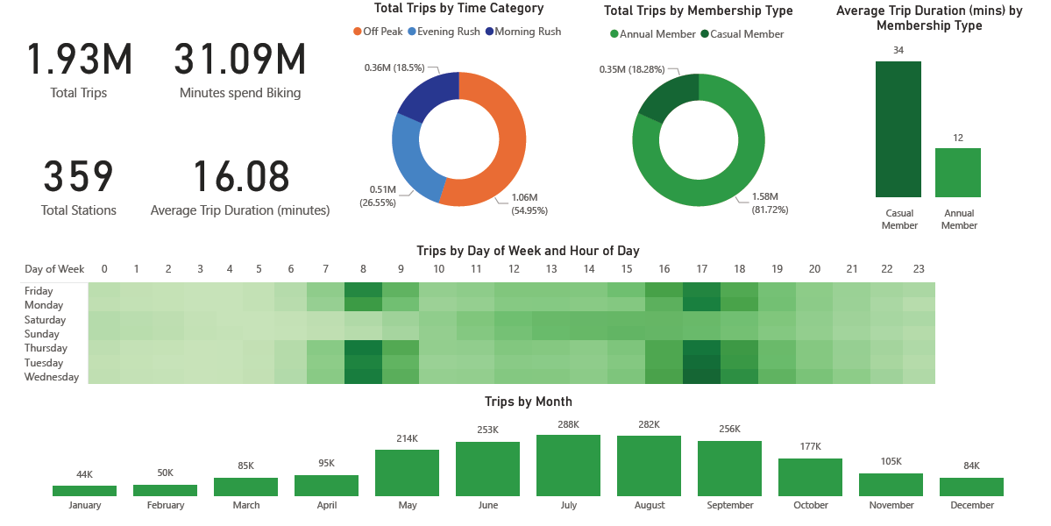
Yearly Overview Dashboard
Created by Mohit Rathod | Data Analyst

Slide 10
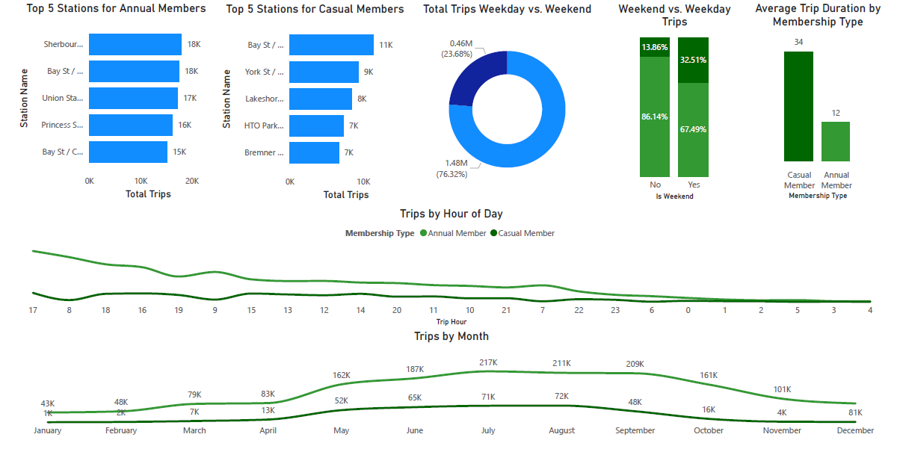
User Behaviour Dashboard
Created by Mohit Rathod | Data Analyst

Slide 11
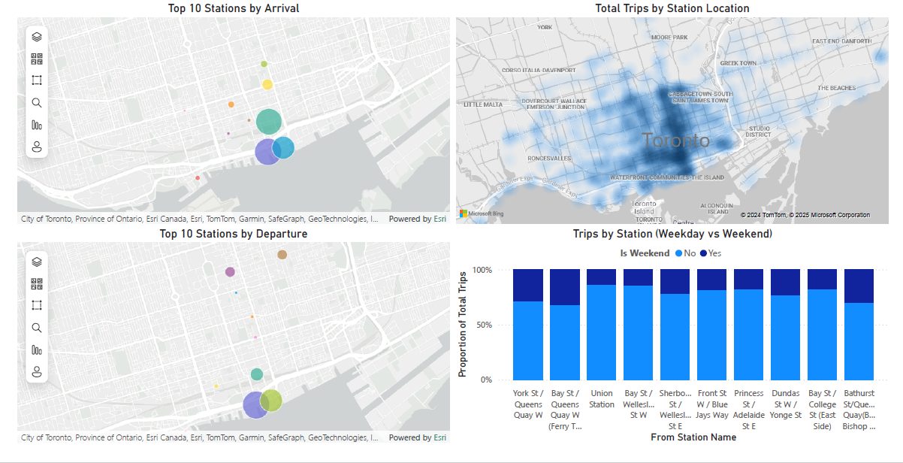
Station Popularity Dashboard
Created by Mohit Rathod | Data Analyst

Slide 12
Project Resources & Data Sources
🔗 Ridership Data:
https://open.toronto.ca/dataset/bike-share-toronto-ridership-data/
📍 Station Info Data: https://tor.publicbikesystem.net/ube/gbfs/v1/en/station_information
📂 Project Folder: https://drive.google.com/drive/folders/1kU3_DJn3UNOTw2EQle_JFQ_fbSdcoPjS
📄 Detailed Report:
https://www.linkedin.com/posts/mohit-rathod_bike-share-toronto-prediction-and-classification-activity-7262117039157178368-GvsM
Created by Mohit Rathod | Data Analyst

Slide 13



Thank You!
Do you have any questions?
Mohitrathod.ca@gmail.com
Maven Analytics Portfolio
Find me on LinkedIn!
Created by Mohit Rathod | Data Analyst

